Slide 1
Basic Business Statistics
11th Edition
Chapter 4
Basic Probability
Basic Business Statistics, 11e © 2009 Prentice-Hall, Inc.
Chap 4-<number>

Slide 2
Learning Objectives
In this chapter, you learn:
Basic probability concepts
Conditional probability
To use Bayes’ Theorem to revise probabilities
Various counting rules
Basic Business Statistics, 11e © 2009 Prentice-Hall, Inc..
Chap 4-<number>

Slide 3
Basic Probability Concepts
Probability – the chance that an uncertain event will occur (always between 0 and 1)
Impossible Event – an event that has no chance of occurring (probability = 0)
Certain Event – an event that is sure to occur (probability = 1)
Basic Business Statistics, 11e © 2009 Prentice-Hall, Inc..
Chap 4-<number>

Slide 4
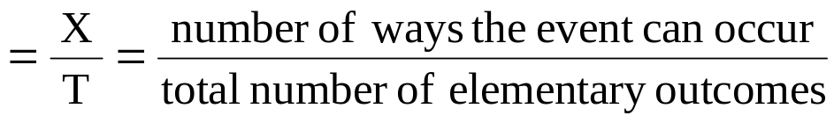
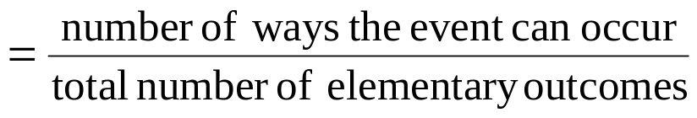
Assessing Probability
There are three approaches to assessing the probability of an uncertain event:
1. a priori -- based on prior knowledge of the process
2. empirical probability
3. subjective probability
probability of occurrence
Assuming all outcomes are equally likely
probability of occurrence
based on a combination of an individual’s past experience, personal opinion, and analysis of a particular situation
Basic Business Statistics, 11e © 2009 Prentice-Hall, Inc..
Chap 4-<number>

Slide 5
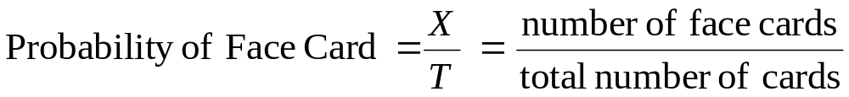
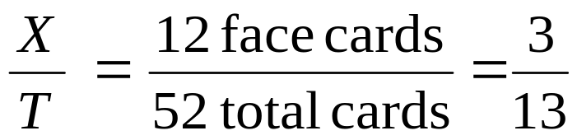
Example of a priori probability
Find the probability of selecting a face card (Jack, Queen, or King) from a standard deck of 52 cards.
Basic Business Statistics, 11e © 2009 Prentice-Hall, Inc..
Chap 4-<number>

Slide 6
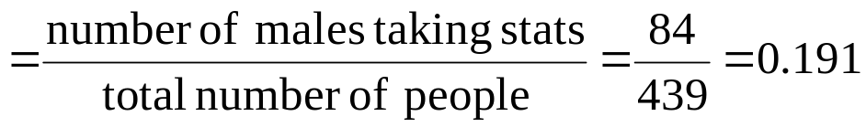
Example of empirical probability
Find the probability of selecting a male taking statistics from the population described in the following table:
 | Taking Stats | Not Taking Stats | Total
Male | 84 | 145 | 229
Female | 76 | 134 | 210
Total | 160 | 279 | 439
Probability of male taking stats
Basic Business Statistics, 11e © 2009 Prentice-Hall, Inc..
Chap 4-<number>

Slide 7
Events
Each possible outcome of a variable is an event.
Simple event
  An event described by a single characteristic
  e.g., A red card from a deck of cards
Joint event
  An event described by two or more characteristics
  e.g., An ace that is also red from a deck of cards
Complement of an event A (denoted A’)
  All events that are not part of event A
  e.g., All cards that are not diamonds
Basic Business Statistics, 11e © 2009 Prentice-Hall, Inc..
Chap 4-<number>

Slide 8

Sample Space
The Sample Space is the collection of all possible events
e.g. All 6 faces of a die:
e.g. All 52 cards of a bridge deck:
Basic Business Statistics, 11e © 2009 Prentice-Hall, Inc..
Chap 4-<number>

Slide 9
Visualizing Events
Contingency Tables
Decision Trees
Ace Not Ace Total
Black 2 24 26
Red 2 24 26
Total 4 48 52
2
24
2
24
Sample Space
Ace
Sample Space
Black Card
Full Deck
of 52 Cards
Not an Ace
Ace
Red Card
Not an Ace
Basic Business Statistics, 11e © 2009 Prentice-Hall, Inc..
Chap 4-<number>

Slide 10
Visualizing Events
Venn Diagrams
  Let A = aces
  Let B = red cards
A ∩ B = ace and red
A
B
A U B = ace or red
Basic Business Statistics, 11e © 2009 Prentice-Hall, Inc..
Chap 4-<number>

Slide 11
Definitions
Simple vs. Joint Probability
Simple Probability refers to the probability of a simple event.
  ex. P(King)
  ex. P(Spade)
Joint Probability refers to the probability of an occurrence of two or more events (joint event).
  ex. P(King and Spade)
Basic Business Statistics, 11e © 2009 Prentice-Hall, Inc..
Chap 4-<number>

Slide 12
Mutually Exclusive Events
Mutually exclusive events
  Events that cannot occur simultaneously
Example: Drawing one card from a deck of cards
  A = queen of diamonds; B = queen of clubs
  Events A and B are mutually exclusive
Basic Business Statistics, 11e © 2009 Prentice-Hall, Inc..
Chap 4-<number>

Slide 13
Collectively Exhaustive Events
Collectively exhaustive events
  One of the events must occur
  The set of events covers the entire sample space
example:
A = aces; B = black cards;
C = diamonds; D = hearts
  Events A, B, C and D are collectively exhaustive (but not mutually exclusive – an ace may also be a heart)
  Events B, C and D are collectively exhaustive and also mutually exclusive
Basic Business Statistics, 11e © 2009 Prentice-Hall, Inc..
Chap 4-<number>

Slide 14
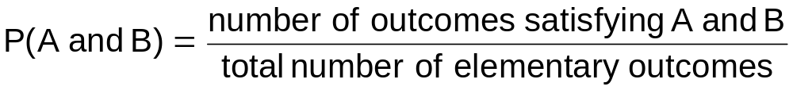
Computing Joint and
Marginal Probabilities
The probability of a joint event, A and B:
Computing a marginal (or simple) probability:
    Where B₁, B₂, …, B_{k} are k mutually exclusive and collectively exhaustive events
Basic Business Statistics, 11e © 2009 Prentice-Hall, Inc..
Chap 4-<number>

Slide 15
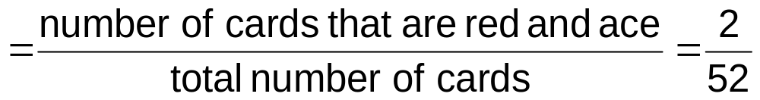
Joint Probability Example
P(Red and Ace)
Color
Type
Total
Red
Black
Ace
2
2
4
Non-Ace
24
24
48
Total
26
26
52
Basic Business Statistics, 11e © 2009 Prentice-Hall, Inc..
Chap 4-<number>

Slide 16
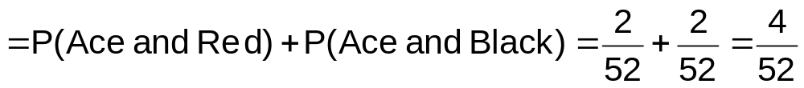
Marginal Probability Example
P(Ace)
Color
Type
Total
Red
Black
Ace
2
2
4
Non-Ace
24
24
48
Total
26
26
52
Basic Business Statistics, 11e © 2009 Prentice-Hall, Inc..
Chap 4-<number>

Slide 17
Marginal & Joint Probabilities In A Contingency Table
Event
Event
B₁
B₂
Total
A₁
P(A₁ and B₁)
P(A₁ and B₂)
P(A₁)
A₂
P(A₂ and B₁)
P(A₂ and B₂)
P(A₂)
Total
P(B₁)
P(B₂)
1
Joint Probabilities
Marginal (Simple) Probabilities
Basic Business Statistics, 11e © 2009 Prentice-Hall, Inc..
Chap 4-<number>

Slide 18

Probability Summary So Far
Probability is the numerical measure of the likelihood that an event will occur
The probability of any event must be between 0 and 1, inclusively
The sum of the probabilities of all mutually exclusive and collectively exhaustive events is 1
1
Certain
0 ≤ P(A) ≤ 1 For any event A
0.5
0
Impossible
If A, B, and C are mutually exclusive and collectively exhaustive
Basic Business Statistics, 11e © 2009 Prentice-Hall, Inc..
Chap 4-<number>

Slide 19
General Addition Rule
General Addition Rule:
P(A or B) = P(A) + P(B) - P(A and B)
If A and B are mutually exclusive, then
P(A and B) = 0, so the rule can be simplified:
P(A or B) = P(A) + P(B)
For mutually exclusive events A and B
Basic Business Statistics, 11e © 2009 Prentice-Hall, Inc..
Chap 4-<number>

Slide 20
General Addition Rule Example
P(Red or Ace) = P(Red) +P(Ace) - P(Red and Ace)
= 26/52 + 4/52 - 2/52 = 28/52
Don’t count the two red aces twice!
Color
Type
Total
Red
Black
Ace
2
2
4
Non-Ace
24
24
48
Total
26
26
52
Basic Business Statistics, 11e © 2009 Prentice-Hall, Inc..
Chap 4-<number>

Slide 21
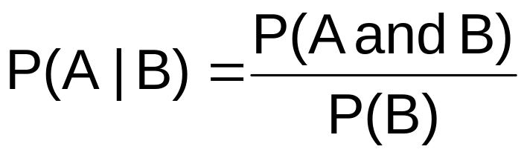
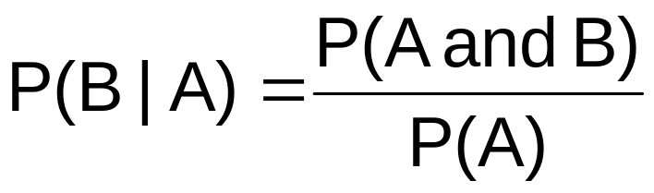
Computing Conditional Probabilities
A conditional probability is the probability of one event, given that another event has occurred:
The conditional probability of A given that B has occurred
The conditional probability of B given that A has occurred
Where P(A and B) = joint probability of A and B
P(A) = marginal or simple probability of A
P(B) = marginal or simple probability of B
Basic Business Statistics, 11e © 2009 Prentice-Hall, Inc..
Chap 4-<number>

Slide 22
Conditional Probability Example
Of the cars on a used car lot, 70% have air conditioning (AC) and 40% have a CD player (CD). 20% of the cars have both.
What is the probability that a car has a CD player, given that it has AC ?
i.e., we want to find P(CD | AC)
Basic Business Statistics, 11e © 2009 Prentice-Hall, Inc..
Chap 4-<number>

Slide 23
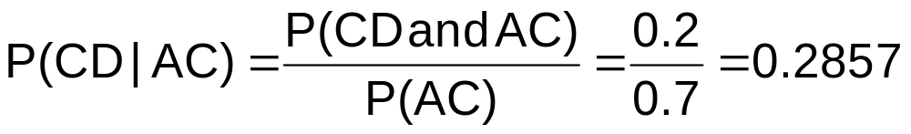
Conditional Probability Example
(continued)
Of the cars on a used car lot, 70% have air conditioning (AC) and 40% have a CD player (CD).
20% of the cars have both.
CD
No CD
Total
AC
0.2
0.5
0.7
No AC
0.2
0.1
0.3
Total
0.4
0.6
1.0
Basic Business Statistics, 11e © 2009 Prentice-Hall, Inc..
Chap 4-<number>

Slide 24
Conditional Probability Example
(continued)
Given AC, we only consider the top row (70% of the cars). Of these, 20% have a CD player. 20% of 70% is about 28.57%.
CD
No CD
Total
AC
0.2
0.5
0.7
No AC
0.2
0.1
0.3
Total
0.4
0.6
1.0
Basic Business Statistics, 11e © 2009 Prentice-Hall, Inc..
Chap 4-<number>

Slide 25




Using Decision Trees
Given AC or no AC:
Has CD
P(AC and CD) = 0.2
P(AC)= 0.7
Does not have CD
P(AC and CD’) = 0.5
Has AC
All
Cars
Conditional
Probabilities
Does not have AC
Has CD
P(AC’ and CD) = 0.2
P(AC’)= 0.3
Does not have CD
P(AC’ and CD’) = 0.1
Basic Business Statistics, 11e © 2009 Prentice-Hall, Inc..
Chap 4-<number>

Slide 26



Using Decision Trees
(continued)
Given CD or no CD:
Has AC
P(CD and AC) = 0.2
P(CD)= 0.4
Does not have AC
P(CD and AC’) = 0.2
Has CD
All
Cars
Conditional
Probabilities
Does not have CD
Has AC
P(CD’ and AC) = 0.5
P(CD’)= 0.6
Does not have AC
P(CD’ and AC’) = 0.1
Basic Business Statistics, 11e © 2009 Prentice-Hall, Inc..
Chap 4-<number>

Slide 27

Independence
Two events are independent if and only if:
Events A and B are independent when the probability of one event is not affected by the fact that the other event has occurred
Basic Business Statistics, 11e © 2009 Prentice-Hall, Inc..
Chap 4-<number>

Slide 28
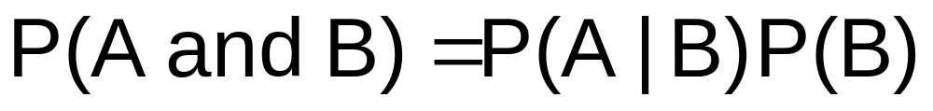


Multiplication Rules
Multiplication rule for two events A and B:
Note: If A and B are independent, then
and the multiplication rule simplifies to
Basic Business Statistics, 11e © 2009 Prentice-Hall, Inc..
Chap 4-<number>

Slide 29
Marginal Probability
Marginal probability for event A:
  Where B₁, B₂, …, B_{k} are k mutually exclusive and collectively exhaustive events
Basic Business Statistics, 11e © 2009 Prentice-Hall, Inc..
Chap 4-<number>

Slide 30
Bayes’ Theorem
Bayes’ Theorem is used to revise previously calculated probabilities based on new information.
Developed by Thomas Bayes in the 18th Century.
It is an extension of conditional probability.
Basic Business Statistics, 11e © 2009 Prentice-Hall, Inc..
Chap 4-<number>

Slide 31
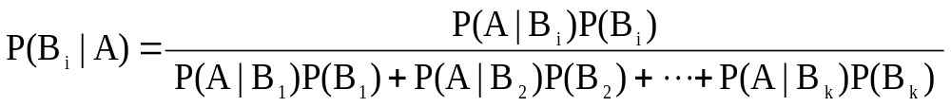
Bayes’ Theorem
where:
B_{i} = i^{th} event of k mutually exclusive and collectively
exhaustive events
A = new event that might impact P(B_{i})
Basic Business Statistics, 11e © 2009 Prentice-Hall, Inc..
Chap 4-<number>

Slide 32

Bayes’ Theorem Example
A drilling company has estimated a 40% chance of striking oil for their new well.
A detailed test has been scheduled for more information. Historically, 60% of successful wells have had detailed tests, and 20% of unsuccessful wells have had detailed tests.
Given that this well has been scheduled for a detailed test, what is the probability
that the well will be successful?
Basic Business Statistics, 11e © 2009 Prentice-Hall, Inc..
Chap 4-<number>

Slide 33
Bayes’ Theorem Example
(continued)
Let S = successful well
U = unsuccessful well
P(S) = 0.4 , P(U) = 0.6 (prior probabilities)
Define the detailed test event as D
Conditional probabilities:
    P(D|S) = 0.6 P(D|U) = 0.2
Goal is to find P(S|D)
Basic Business Statistics, 11e © 2009 Prentice-Hall, Inc..
Chap 4-<number>

Slide 34
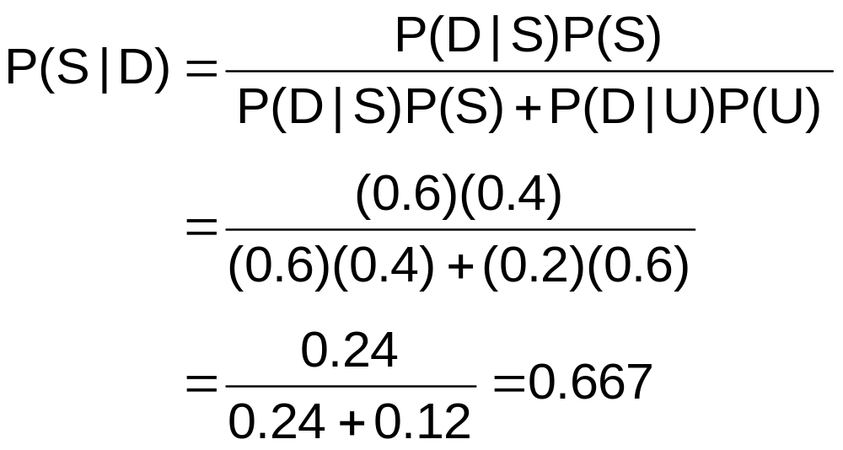
Bayes’ Theorem Example
(continued)
Apply Bayes’ Theorem:
So the revised probability of success, given that this well has been scheduled for a detailed test, is 0.667
Basic Business Statistics, 11e © 2009 Prentice-Hall, Inc..
Chap 4-<number>

Slide 35
Bayes’ Theorem Example
(continued)
Given the detailed test, the revised probability of a successful well has risen to 0.667 from the original estimate of 0.4
Event | Prior Prob. | Conditional Prob. | Joint Prob. | Revised Prob.
S (successful) | 0.4 | 0.6 | (0.4)(0.6) = 0.24 | 0.24/0.36 = 0.667
U (unsuccessful) | 0.6 | 0.2 | (0.6)(0.2) = 0.12 | 0.12/0.36 = 0.333
Sum = 0.36
Basic Business Statistics, 11e © 2009 Prentice-Hall, Inc..
Chap 4-<number>

Slide 36
Counting Rules
Rules for counting the number of possible outcomes
Counting Rule 1:
  If any one of k different mutually exclusive and collectively exhaustive events can occur on each of n trials, the number of possible outcomes is equal to
  Example
    If you roll a fair die 3 times then there are 6³ = 216 possible outcomes
k^{n}
Basic Business Statistics, 11e © 2009 Prentice-Hall, Inc..
Chap 4-<number>

Slide 37
Counting Rules
(continued)
Counting Rule 2:
  If there are k₁ events on the first trial, k₂ events on the second trial, … and k_{n} events on the n^{th} trial, the number of possible outcomes is
  Example:
    You want to go to a park, eat at a restaurant, and see a movie. There are 3 parks, 4 restaurants, and 6 movie choices. How many different possible combinations are there?
    Answer: (3)(4)(6) = 72 different possibilities
(k₁)(k₂)…(k_{n})
Basic Business Statistics, 11e © 2009 Prentice-Hall, Inc..
Chap 4-<number>

Slide 38
Counting Rules
(continued)
Counting Rule 3:
  The number of ways that n items can be arranged in order is
  Example:
    You have five books to put on a bookshelf. How many different ways can these books be placed on the shelf?
    Answer: 5! = (5)(4)(3)(2)(1) = 120 different possibilities
n! = (n)(n – 1)…(1)
Basic Business Statistics, 11e © 2009 Prentice-Hall, Inc..
Chap 4-<number>

Slide 39
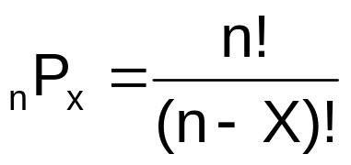
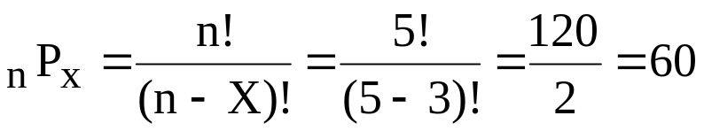
Counting Rules
(continued)
Counting Rule 4:
  Permutations: The number of ways of arranging X objects selected from n objects in order is
  Example:
    You have five books and are going to put three on a bookshelf. How many different ways can the books be ordered on the bookshelf?
    Answer: different possibilities
Basic Business Statistics, 11e © 2009 Prentice-Hall, Inc..
Chap 4-<number>

Slide 40
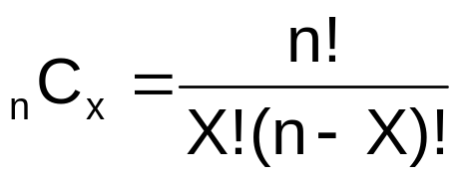
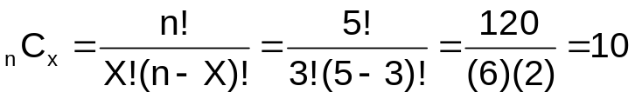
Counting Rules
(continued)
Counting Rule 5:
  Combinations: The number of ways of selecting X objects from n objects, irrespective of order, is
  Example:
    You have five books and are going to select three are to read. How many different combinations are there, ignoring the order in which they are selected?
    Answer: different possibilities
Basic Business Statistics, 11e © 2009 Prentice-Hall, Inc..
Chap 4-<number>

Slide 41
Chapter Summary
Discussed basic probability concepts
  Sample spaces and events, contingency tables, Venn diagrams, simple probability, and joint probability
Examined basic probability rules
  General addition rule, addition rule for mutually exclusive events, rule for collectively exhaustive events
Defined conditional probability
  Statistical independence, marginal probability, decision trees, and the multiplication rule
Discussed Bayes’ theorem
Examined counting rules
Basic Business Statistics, 11e © 2009 Prentice-Hall, Inc..
Chap 4-<number>

